Slide 1
Project 4 Intro & How To
EECS 485, Web Systems

Slide 2
Disclaimer
This slide deck is necessary for the project. It will give you a holistic view of the MapReduce ecosystem. It will then extend that knowledge into the project 4 spec. You should read this before the spec to improve your understanding of the project requirements.
This is NOT a replacement for the project spec.
You MUST read this. We will not help you in office hours if you have not read this slide deck first.

Slide 3
Outline
MapReduce Introduction
Internal implementation details
Example Walkthrough of WordCount
Running via Command Line
vs. Running on MapReduce Server
Project 4 Details
Testing & Debugging

Slide 4
MapReduce (Re) Introduction

Slide 5
MapReduce (MR) Framework
MR used to distribute data processing across large cluster of machines
BUT you must abstract your problem into MR’s programming model
Using “map” and “reduce” programs instead of a normal script
It hides the complexity of distributed work
Lets users focus on the Map and Reduce programs only

Slide 6
MR’s Programming Model
You must abstract your original problem into Map and Reduce subproblems
Map: Process some input data and output intermediate (key, value) pairs
Input: <data>
Output: list(key, value)
Reduce: Accept all values for a given intermediate key, and reduce the values to a smaller set (key is optional in output data)
Input: key, list(value)
Output: key, value
The Reducer can output 1 or more (key, value) pairs

Slide 7
MapReduce Internal Details

Slide 8
MapReduce Server
MapReduce is a programming model
It’s implemented by a MapReduce Server (e.g. Hadoop, Google’s MapReduce, Apache Spark, your project 4!)
The Server consists of:
1 Master
Multiple Workers controlled by the Master
A new MR job sent to the Server consists of:
Input data
Map and Reduce programs
The Server runs this new job to completion

Slide 9
Master
Gets a new job, looks at number of workers and input files
Decides which workers should process which files
Internally handles the Group stage of MapReduce
Makes sure that the data for a single key ends up in the same place
Manages the disk space for all Workers
i.e. copying and moving files across machines
Makes sure each Worker is alive and handles fault tolerance
And a lot more!
You can read more in the original MapReduce paper here

Slide 10
Worker
Gets a set of input files and a Map or Reduce executable to run on them
Doesn’t need to know if running Map or Reduce job
It's just running an executable
Mapper/Reducer = Worker running a Map or Reduce executable

Slide 11
Job Stages
Map: reads the original input and maps to intermediate (key, value) pairs
Reads data from input directory, writes data to var/job-0/mapper/
Group: sorts the intermediate Map output by key
Reads data from var/job-0/mapper, writes data to var/job-0/grouper
Reduce: gets all values for a specific key and reduces data to a new form
Reads data from var/job-0/grouper, writes data to var/job-0/reducer
New form could be new (key, value) pairs or a single value for each key
All stages run sequentially (i.e. group will run after all mappers have finished)
MR programs often implement pipeline of jobs
i.e. output of one Map/Reduce program could be fed into another Map/Reduce program, and so on

Slide 12
Bigly Note about Reduce Stage
In some MapReduce implementations, a reducer will get only one key
In others, such as implementations we use in this class, a reducer will receive the data for multiple keys
BUT, it will get ALL the values for every key it sees
Once it sees a new key, it can assume it has seen all values for the current key
Note: Reducer input is a list of (key, value) pairs separated by a tab
Not a single key followed a list of values

Slide 13
Heartbeat & Fault Tolerance
Workers will crash mid-jobs because machines fail in the real world
So Master maintains heartbeat communication with each Worker
Many different ways to implement heartbeat:
Master could ping each worker every 2 seconds
Worker could tell the Master it’s alive every 2 seconds
On failure, create a new Worker and restart the job it was doing (if any)

Slide 14
Example Walkthrough: WordCount

Slide 15
WordCount Problem
Given a large input data set, how can we do frequency analysis on the words?
MapReduce!

Slide 16
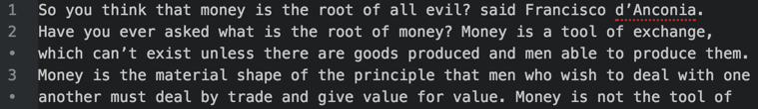
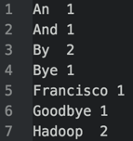
Input and Output Data
Sample Input File:
Sample Final Output of WordCount:

Slide 17
Abstract WordCount
Divide WordCount into Map and Reduce subproblems
Map: read some input data, output how often it sees each word
Or just output (word, 1) for every word instead of keeping count
Reduce: for each word, count total number of times it was seen
Note how they are independent:
We can run multiple mappers with small input sizes
Input of mappers doesn’t matter
Reducers are isolated to only worry about ONE key
So we can run multiple reducers without any issues
Group stage will take care of sorting by key

Slide 18
Map Stage
Data:
Input: Text file
Output: List of (word, count)
Worker reads input data from file, and pipes it into the mapper executable. The output is piped into another file
For every word it sees, our Map will output (word, 1)
This way, we don’t have to read the full file first and store it in memory
But you may want to read all the input and emit the final word count instead
Saves work down the pipeline, especially during grouping

Slide 19
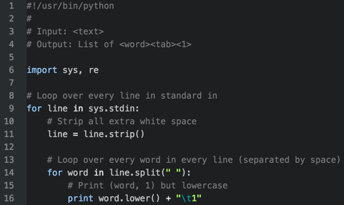
Map Code: /exec/word_count/map.py

Slide 20
Reduce Stage
Data:
Input: List of (word, 1) pairs
Output: List of (word, count)
Worker reads input data from file, and pipes it into the reducer executable. The output is piped into another file
Our Reduce will read all pairs for a given word
Then, print out final count for each word before starting count for next word
Remember, Reduce can get multiple keys’ data!
But as soon as it sees a new key, it can assume all values for the current key have been read

Slide 21
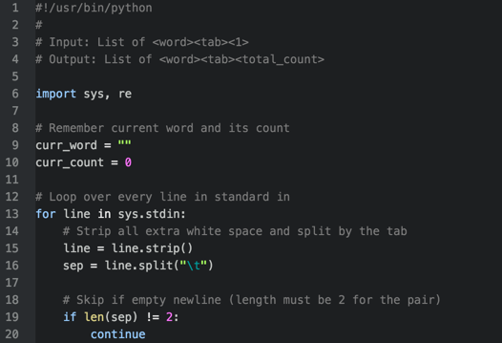
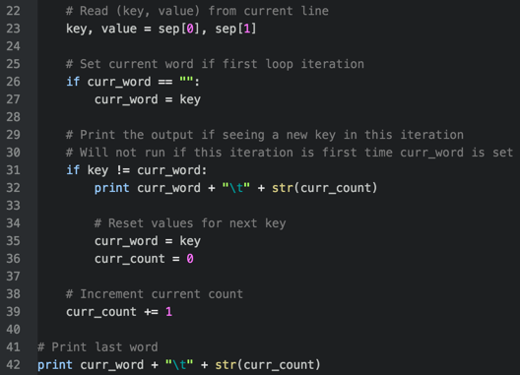
Reduce Code: /exec/word_count/reduce.py

Slide 22
Run via Command Line
Print all input to standard in:
cat input/sample1/*
Print some string to standard in:
echo E\\nD\\nC\\nC\\nD
\\n = newline character in bash
Run the Map executable on some input from standard in:
echo E\\nD\\nC\\nC\\nD | ./exec/word_count/map.py
Run one Map executable on the entire input folder:
cat input/sample1/* | ./exec/word_count/map.py

Slide 23
Run via Command Line
Sort some data from standard in:
echo E\\nD\\nC\\nC\\nD | sort
Do the Group stage by sorting Mapper output:
cat input/sample1/* | ./exec/word_count/map.py | sort
Run the Reduce executable on some input from standard in:
echo c\\t1\\nc\\t1\\nd\\t1 | ./exec/word_count/reduce.py
\\t = tab character in bash
Finally, pipeline the Mapper and Reducer to work together:
cat input/sample1/* | ./exec/word_count/map.py | sort | ./exec/word_count/reduce.py

Slide 24
WWMRSD? What Would MapReduce Server Do?
We just saw it happen in command line
Use that to generate ground truth for all input files!!!
We do not give you any ground truth so you have to run these commands
MR server would have divided the input file among each Worker instead of sending all input to a single one
It will also run Group internally (not a basic sort)

Slide 25
Project 4: Naive MapReduce Server

Slide 26
Project Goals
Implement a naive MapReduce Server
Not writing any Map or Reduce executables for this project
New jobs will actually tell you what executable to run
All executables will handle input/output via standard in/out
You will write the Master and Worker classes
We give you start.py which creates a new Master, which takes over the whole process
At the end, we can start your MR server with any number of workers and run any kind of MapReduce job on it

Slide 27
Advanced Python Topics
In this project, we use three new things:
Sockets
Processes
Threads

Slide 28
Sockets
Sockets are used to communicate over the web
Used to send data and to listen for data on a SPECIFIC port number
Two types of sockets:
TCP: Reliable, ordered
UDP: Fast, low overhead, unreliable
Project 4 uses UDP sockets for heartbeat communication and TCP sockets for everything else
The Master and the Workers will communicate with each other through sockets

Slide 29
Processes
Process = executing program with a dedicated memory space
Running python app.py creates a new process to run your program
One process cannot access the memory space of another process
In Project 4, your Master will create each new Worker on a different process

Slide 30
Threads
Threads are similar to processes but are owned by a single Process
If the Process dies, all threads under it die
Multiple threads can access the same memory space and data structures
When you start a new process, a main default thread is created automatically and this thread runs your code
In Project 4,
The Master’s and each Worker’s main thread will listen on TCP socket for messages
The Master will have 2 other threads: one to listen for UDP heartbeat messages, the other to handle fault tolerance
Each Worker will have 1 other thread to send heartbeat messages to the Master
The Master and Workers will also use a temporary thread to do part of the setup

Slide 31
Master Class
Our start.py creates a new instance of Master which should take over the entire process (and never stop running)
The Master will:
Create a new TCP socket to listen for and to send data
Listen for new jobs, as well as updates from each Worker
Send new jobs to Workers using this socket as well
Create Worker processes
Create a UDP socket to listen for heartbeat messages from Workers
Handle fault tolerance by making sure Workers are always alive
Note: the main default thread will never end or return as it will always keep listening for new messages on the TCP socket.
All other work is done in threads

Slide 32
Worker Class
Master will create multiple instances of the Worker class
Worker will:
Create a TCP socket to listen for and to send data
Listen for new jobs to run by the Master
Send update to Master when finished with job
Create a UDP socket to send heartbeat messages to the Master
Note, again, that the main default thread will never end or return as it will also keep listening on the TCP socket for new messages

Slide 33
Project Diagram
The next page shows you a holistic view of what you are building
Look at it again after reading the whole spec
We give you start.py, which you cannot change, and this will create a new instance of the Master class
Master will then take over execution and its __init__ function will never return
We also give you send_job.py to send a new job to the Master using TCP sockets
Can be used for testing but you will need more thorough test cases

Slide 34
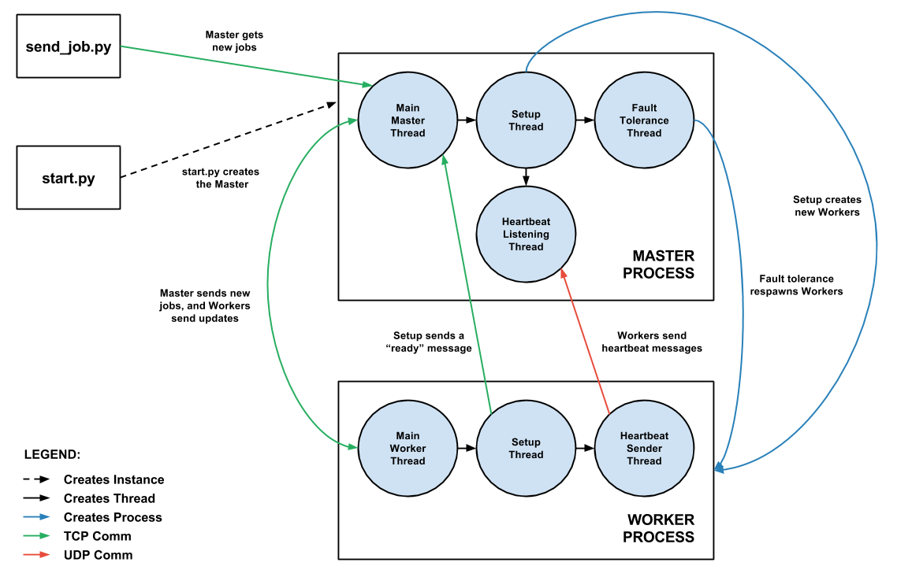

Slide 35
How to do Fault Tolerance
For this project, your Worker’s heartbeat thread will create a UDP socket to send a basic ping to the Master every 2 second
The Master also has a UDP socket setup to listen for these heartbeat messages and update internal data structures
The Master also has a fault tolerance thread that will check the status of each Worker every 10 seconds
If a Worker hasn’t been heard from it in 10 seconds, it will assume the Worker is dead and restart it

Slide 36
New Job Comes In...
What does the Master do when a new job comes in (via TCP)?
Master reads the input directory and divides the file into approximately X parts
X = # of available Workers
Master sends TCP messages to each Worker with its work
Master continues listening on TCP socket for new messages
Workers get their Map jobs, run them to completion and then update the Master via TCP that they have finished
Master receives updates on TCP socket as Mappers finish

Slide 37
New Job Comes In...
When all Mappers have finished, Master will read the Mapper output directory, group the data and start the Reducers with the new intermediate input files
Reducer jobs again distributed via TCP socket
Master will group and start Reducers, then continue listening on TCP socket for messages
Reducers will send updates to Master on TCP socket as they finish
When all Reducers have finished, Master will read the Reducer output directory and move the output to a final directory defined in the job creation message.
Master will then check if there are any pending jobs and start this cycle if true, otherwise keep listening on TCP socket
Note that only one job can run at a time so all Workers will always be running one kind of job (either Map or Reduce)

Slide 38
Other (important-enough-to-be-in-this-slide-deck) Stuff

Slide 39
Testing Strategies
Use the command line slides to generate ground truth for given sample data and map/reduce jobs
The Master and the Worker instances should be independent of each other
So do not add extra data dependencies except what’s noted in the spec
The output of your MR Server will be an output directory so you will still need to sort it in order to compare it with the ground truth
Use the same command line arguments
Start with a dummy Worker process creation, UDP heartbeat sockets, move them to separate threads, then move to TCP sockets and running full jobs
This flow will give you an introduction to Processes, Sockets, Threads in that order

Slide 40
How will the AG work?
We will replace your master.py with our master.py in order to test the Worker and vice versa
Hence, be sure that your classes are independent and communicate according to the spec!
We will have modular tests as well as full integration tests

Slide 41
Notes & Tips
This is in Python3!
The details for the implementation are in the spec so be sure to read that
You must follow our exact specs about the socket, thread and process creation because you will fail AG tests otherwise
Get started early. This is not an easy project.

Slide 42
Read the Spec. Good Luck.
This is a big and complicated project, but at the end, you’ll realize how awesome of a system you have built.

